Slide 1
JPA Tutorial Part I
2018/10/18

Slide 2
1. Introduction

Slide 3
Introduction
Object-relational mapping (ORM)
Mapping object models (Java programs) to relational models (database tables, fields) and vice versa
Java Persistence API (JPA)
a vendor independent specification for ORM
Popular JPA Providers
Hibernate, Toplink, EclipseLink and Apache OpenJPA

Slide 4
History
JPA 1.0 - released in 2006 as a part of EJB 3.0 specification.
JPA 2.0 - released in the last of 2009.
It supports validation.
It expands the functionality of object-relational mapping.
It shares the object of cache support.
JPA 2.1 - released in 2013
It allows fetching of objects.
It provides support for criteria update/delete.
It generates schema.
JPA 2.2 - released as a development of maintainenece in 2017.
It supports Java 8 Date and Time.
It provides @Repeatable annotation that can be used when we want to apply the same annotations to a declaration or type use.
It allows JPA annotation to be used in meta-annotations.
It provides an ability to stream a query result.

Slide 5
Components
EntityManager
A class that manages the persistent state(or lifecycle) of an entity.
provides the operations from and to the database
Persistence Unit
a named configuration of entity classes.
described via the persistence.xml file in the META-INF directory of the source folder
Persistence Context
a managed set of entity instances.
Entities
POJO used to be persisted in a database

Slide 6
Types of EntityManagers
Container Managed Entity Managers
the lifecycle of the Entity Manager is managed by the container (for instance, a Java EE container or any other custom container like Spring) of the application
may use transaction-scoped persistence contexts or extended persistence contexts.
Application Managed Entity Managers
the lifecycle of EntityManager instances is managed by the application.
direct access to the underlying persistence provider

Slide 7
Persistence Context
The JPA persistence context contains the entities managed by the persistence provider.
acts like a first level (transactional) cache for interacting with the datasource.
Loaded entities are placed into the persistence context before being returned to the application.
Entities changes are also placed into the persistence context (to be saved in the database when the transaction commits).

Slide 8
Transaction Management
EntityManager is to determine the lifetime of the Persistence Context.
Transactions are directly related to entities. Managing transactions would mean managing how entities lifecycle(create, update delete) is managed.
Whenever a transaction begins, a Persistence Context instance gets associated with it.
And when a Transaction ends(commits for example), the Persistence Context is flushed and get disassociated with the transaction.

Slide 9
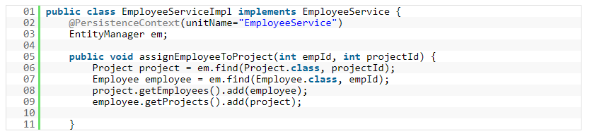
Container Managed Entity Manager
The most common way of acquiring a Container Managed EntityManager is to use @PersistenceContext annotation on an EntityManager attribute.

Slide 10
types of Transaction management
RESOURCE LOCAL Transactions
refer to the native transactions of the JDBC Driver
for example a JDBC Connection.
JTA or GLOBAL Transactions
refer to the transactions of the JEE server.
use JTA transactions When you need two or more resources within a single transaction

Slide 11
JPA configuration - persistence.xml
a standardard configuration file named “persistence.xml “ need to be placed in the META-INF directory inside the JAR file that contains the entity beans.
Content of persistence.xml
a persistence-unit with a unique name
The provider attributes used to specify the underlying implementation of the JPA EntityManager.
entity classes

Slide 12
Entity
Each entity is associated with some metadata that represents the information of it.
Entity metadata
Annotation - In Java, annotations are the form of tags that represents metadata. This metadata persist inside the class.
XML - In this form, metadata persist outside the class in XML file.
Java Bean standard
default constructor or a file that contains serialized instance.
Non-Boolean property contains getter and setter methods.
E.g. the field name is ‘salary’ therefore the getter method of this field is ‘getSalary ()’.
E.g. the field name is ‘salary’ therefore the setter method of this field is ‘setSalary (double sal)’.
Boolean property contain setter and is method.
E.g. the Boolean property ‘empty’, the is method of this field is ‘isEmpty ()’.

Slide 13
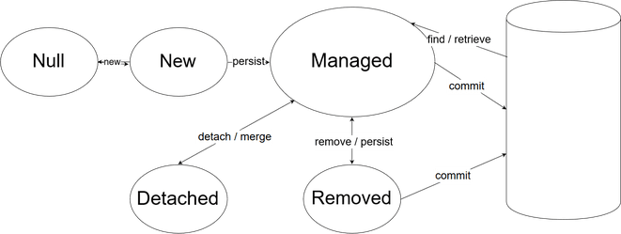
Entities - lifecycle
New (transient):
an entity is new if it has just been instantiated using the new operator, and it is not associated with a persistence context.
not exist in the database
Managed (persistent):
currently associated with a persistence context.
any change to the object will be persisted to the database when the commit method is called
Detached:
no longer associated with a persistence context
can be reattached to the EntityManager through the merge method
Removed:
an instance associated with a persistence context but scheduled for removal from the database.

Slide 14
Annotations for entity class
Annotation | Description
@Entity | This annotation specifies to declare the class as entity or a table.
@Table | This annotation specifies to declare table name.
@Basic | This annotation specifies non constraint fields explicitly.
@Embedded | This annotation specifies the properties of class or an entity whose value instance of an embeddable class.
@Id | This annotation specifies the property, use for identity (primary key of a table) of the class.
@GeneratedValue | This annotation specifies, how the identity attribute can be initialized such as Automatic, manual, or value taken from sequence table.
@Transient | This annotation specifies the property which in not persistent i.e. the value is never stored into database.
@Column | This annotation is used to specify column or attribute for persistence property.
@SequenceGenerator | This annotation is used to define the value for the property which is specified in @GeneratedValue annotation. It creates a sequence.
@TableGenerator | This annotation is used to specify the value generator for property specified in @GeneratedValue annotation. It creates a table for value generation.

Slide 15
Annotation | Description
@AccessType | This type of annotation is used to set the access type. If you set @AccessType(FIELD) then Field wise access will occur. If you set @AccessType(PROPERTY) then Property wise assess will occur.
@JoinColumn | This annotation is used to specify an entity association or entity collection. This is used in many- to-one and one-to-many associations.
@UniqueConstraint | This annotation is used to specify the field, unique constraint for primary or secondary table.
@ColumnResult | This annotation references the name of a column in the SQL query using select clause.
@ManyToMany | This annotation is used to define a many-to-many relationship between the join Tables.
@ManyToOne | This annotation is used to define a many-to-one relationship between the join Tables.
@OneToMany | This annotation is used to define a one-to-many relationship between the join Tables.
@OneToOne | This annotation is used to define a one-to-one relationship between the join Tables.
@NamedQueries | This annotation is used for specifying list of named queries.
@NamedQuery | This annotation is used for specifying a Query using static name.

Slide 16
JPA Primary Key
Every entity object that is stored in the database has a primary key. It represents the entity object as long as it exists in the database.
Once assigned, the primary key cannot be modified.
The @Id annotation marks a field as a primary key field.
Automatic Primary Key
use @GeneratedValue annotation to specify how the primary key is automatically allocated.
Application Set Primary Key
the application is responsible to set a primary key by initializing the primary key field.
Composite Primary Key (@IdClass)
a composite primary key consist of multiple primary key properties
class containing copy of entity PK properties
Embedded Primary Key (@Embeddable)
similar to composite primary key
Class instance containing entity PK properties

Slide 17
Strategies for Automatic Primary Key Generation
GenerationType.AUTO
lets the persistence provider choose the generation strategy
GenerationType.IDENTITY
It relies on an auto-incremented database column and lets the database generate a new value with each insert operation.
GenerationType.SEQUENCE
It requires additional select statements to get the next value from a database sequence.
GenerationType.TABLE
It simulates a sequence by storing and updating its current value in a database.
The default generation type is GenerationType.AUTO.

Slide 18
Direction in Entity Relationships
Unidirectional relationship
In this relationship, only one entity can refer the properties to another.
It contains only one owing side that specifies how an update can be made in the database.
Bidirectional relationship
This relationship contains an owning side as well as an inverse side.
So here every entity has a relationship field or refer the property to other entity.

Slide 19
Multiplicity in Entity Relationships
One-to-one
@OneToOne annotation.
instance of each entity is related to a single instance of another entity.
One-to-many
@OneToMany annotation.
an instance of one entity can be related to more than one instance of another entity.
Many-to-one
@ManyToOne annotation.
multiple instances of an entity can be related to single instance of another entity.
Many-to-many
@ManyToMany annotation.
multiple instances of an entity can be related to multiple instances of another entity. In this mapping, any side can be the owing side.

Slide 20
Fetch Types
Eager fetch
Fetching the whole record while finding the record using Primary Key.
Lazy fetch
It checks for the availability of entities with primary key if it exists.
Then later if you call any of the getter method of that entity then it fetches the whole.
The default depends on the cardinality of the relationship.
All to-one relationships use FetchType.EAGER by default.
all to-many relationships FetchType.LAZY by default.

Slide 21
Cascade Types
Once entities relationship (ex: many-to-one) is established correctly, any entity state changes can propagate from partents to child entities.
CascadeType.PERSIST
save() or persist() operations cascade to related entities.
CascadeType.MERGE
related entities are merged when the owning entity is merged.
CascadeType.REFRESH
reload data from database into related entities
same as refresh() operation
CascadeType.REMOVE
removes all related entities association when the owning entity is deleted.
CascadeType.DETACH
detaches all related entities if a “manual detach” occurs.
CascadeType.ALL :
shorthand for all of the above cascade operations.
By default no operations are cascaded.

Slide 22
2. JPA in eclipse

Slide 23
Enviorment
Java 8
tomcat 7.x
spring 4.3
hibernate 4.3
postgresql 8.4

Slide 24
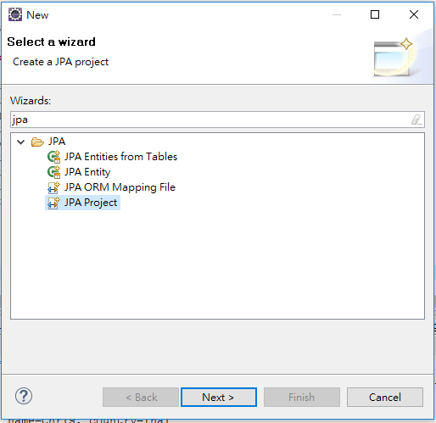
create JPA Project

Slide 25
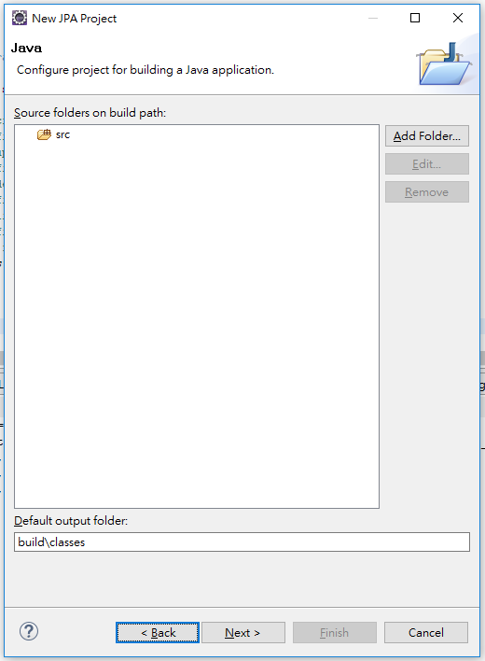
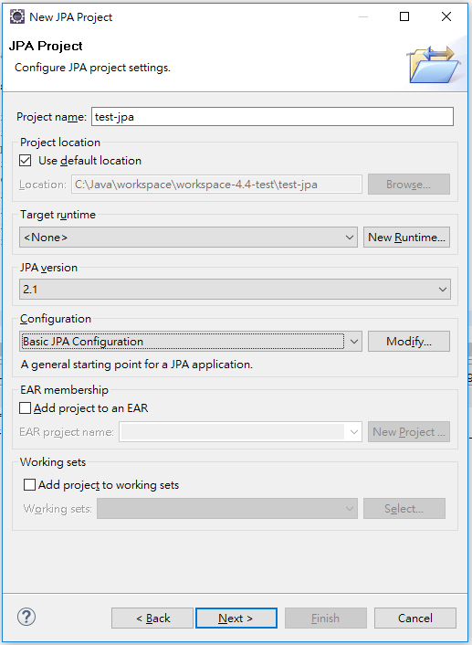
input project name and just press [next]

Slide 26
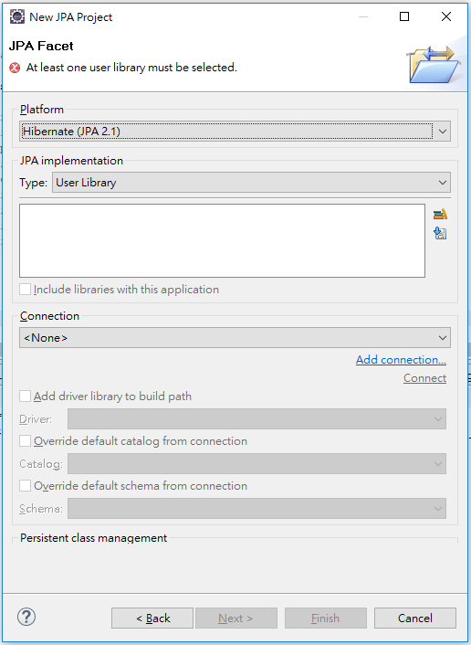
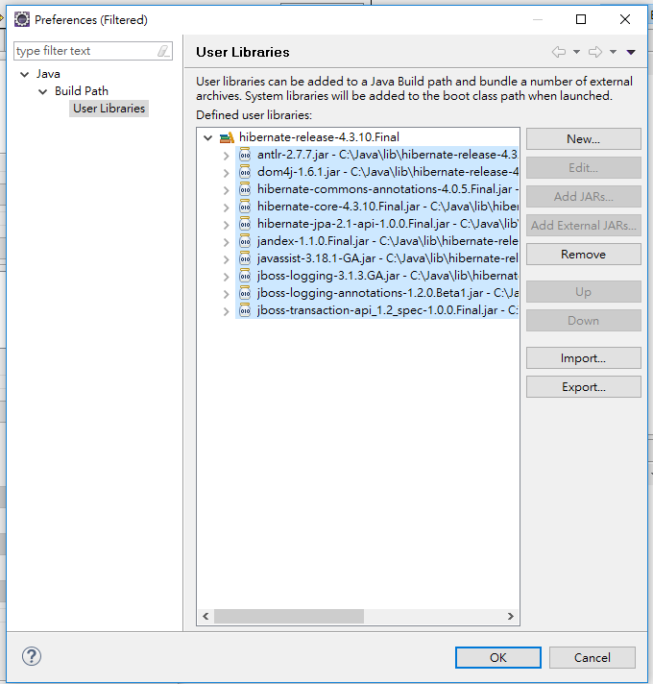
add library for JPA

Slide 27
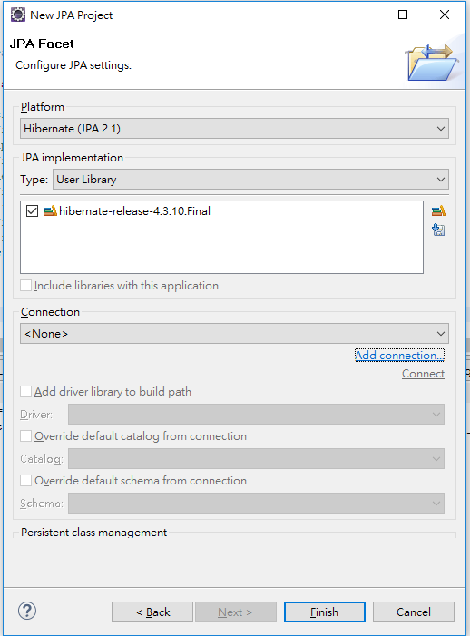
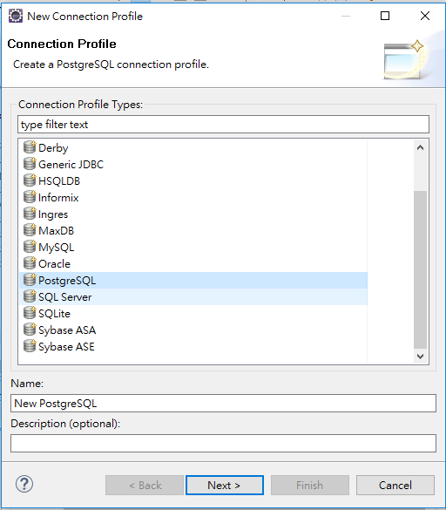
Add connection

Slide 28
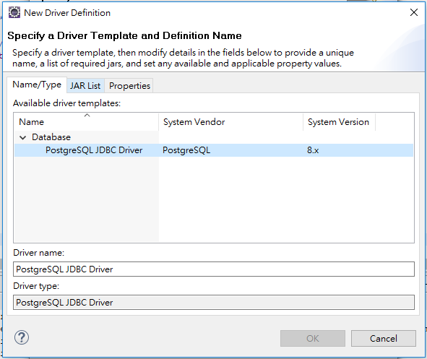
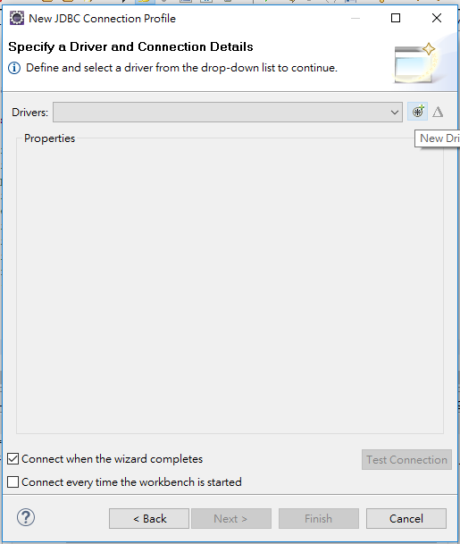
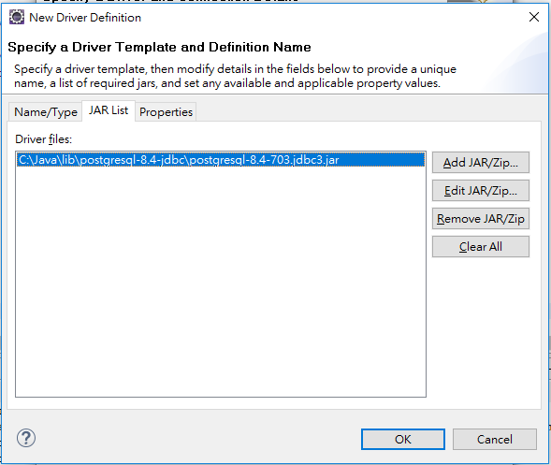
specify jdbc driver

Slide 29
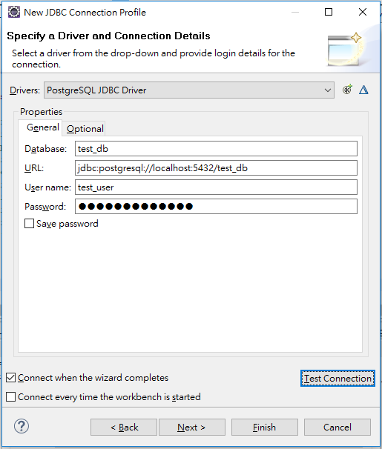
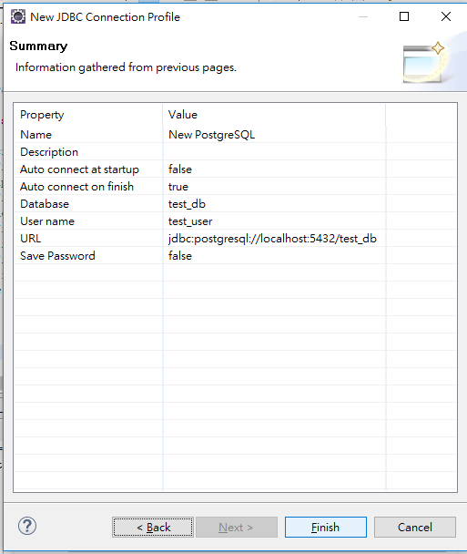

Slide 30
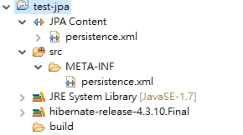
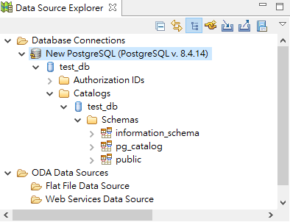
after creating a project
JPA Project structure
Data Source Explorer

Slide 31
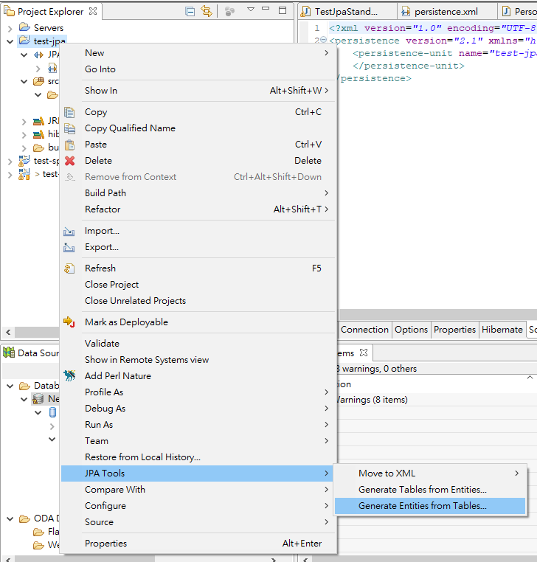
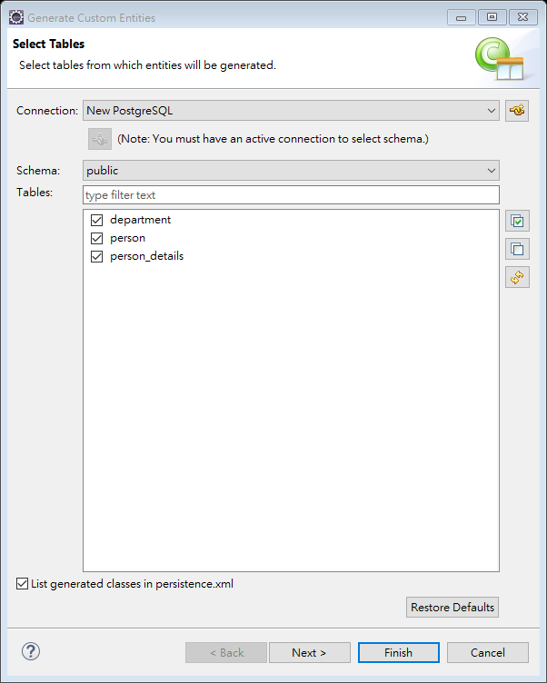
create entities

Slide 32
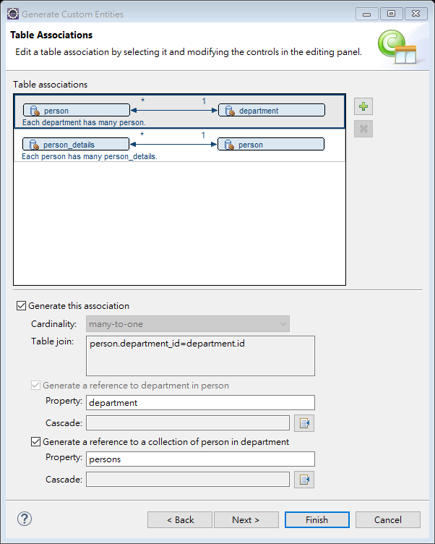
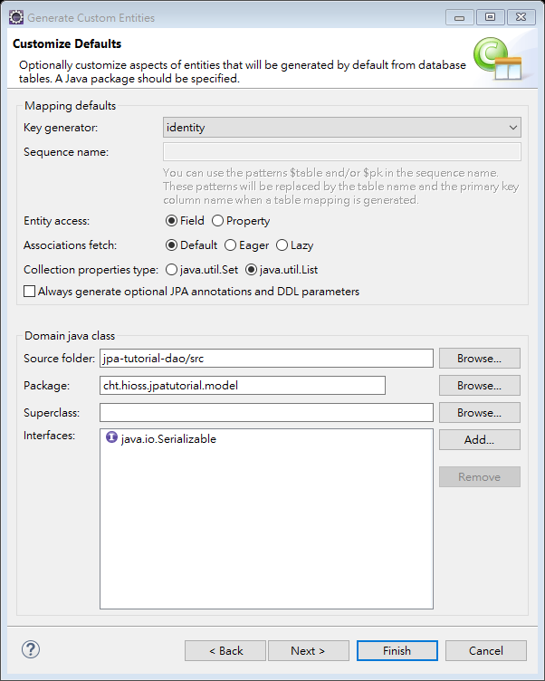
customize table association and defaults

Slide 33
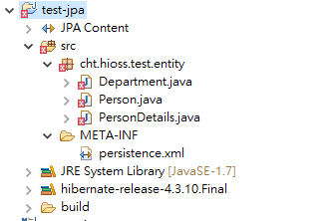
automatically generate entities

Slide 34
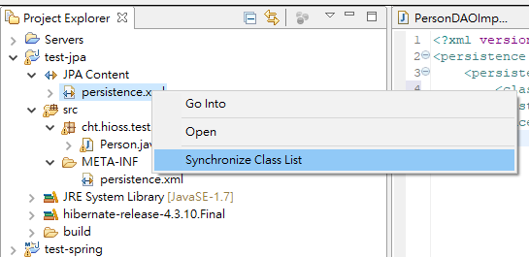
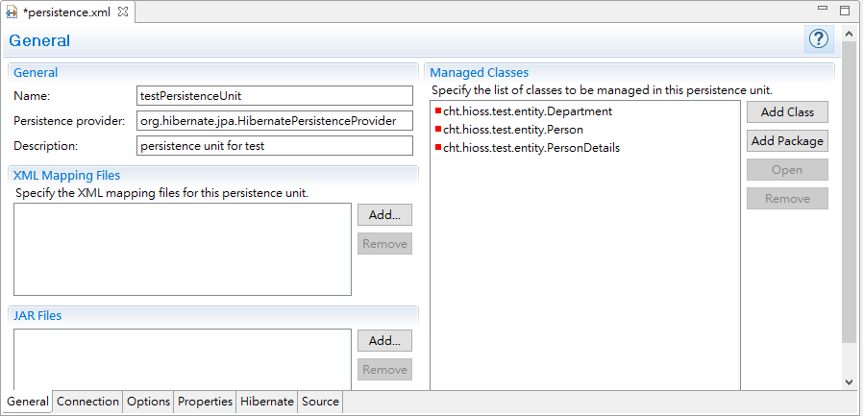
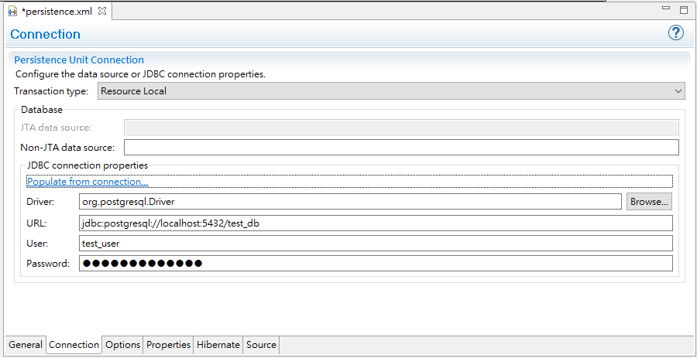
edit persistence.xml (1)

Slide 35
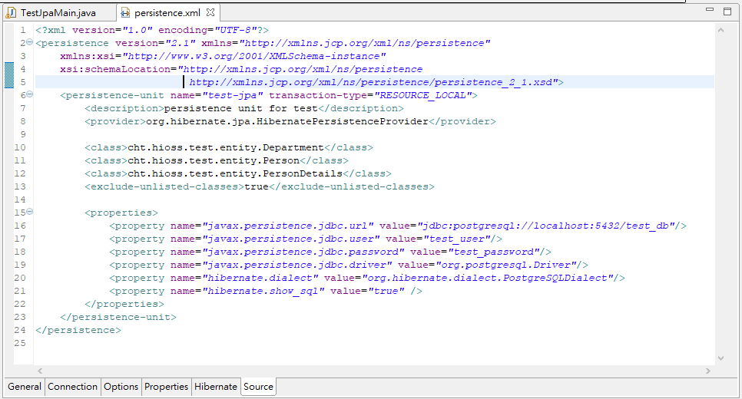
edit persistence.xml(2)

Slide 36
Entity Class
@Entity
@Table(name="PERSON")
public class Person {
@Id
@Column(name="id")
@GeneratedValue(strategy=GenerationType.IDENTITY)
private int id;
private String name;
public int getId() {
return id;
}
public void setId(int id) {
this.id = id;
}
public String getName() {
return name;
}
public void setName(String name) {
this.name = name;
}
@Override
public String toString(){
return "id="+id+", name="+name+", country="+country;
}
}

Slide 37
JPA example
an example of Application-Managed Entity Manager
EntityManagerFactory emFactory = Persistence.createEntityManagerFactory( "LOCAL_PERSISTENCE" );
EntityManager entityManager = emFactory.createEntityManager( );
entityManager.getTransaction( ).begin( );
Person person = new Person();
person.setName("Elvin");
person.setCountry("Denmark");
entityManager.persist(person);
System.out.println("create: " + person.toString());
entityManager.getTransaction().commit();
entityManager.close();
emFactory.close();

Slide 38
References
JPA Tutorial - JPA Introduction
http://www.java2s.com/Tutorials/Java/JPA/index.htm
JPA Tutorial
https://www.tutorialspoint.com/jpa/index.htm
A Guide to JPA with Spring
https://www.baeldung.com/the-persistence-layer-with-spring-and-jpa
Hibernate ORM 5.3.7.Final User Guide
http://docs.jboss.org/hibernate/orm/5.3/userguide/html_single/Hibernate_User_Guide.html
Spring Framework reference
https://docs.spring.io/spring/docs/4.3.x/spring-framework-reference/html/index.html

